Slide 1
async&await in JS

Slide 2
agenda
Usage of async&await
async in angularJS

Slide 3
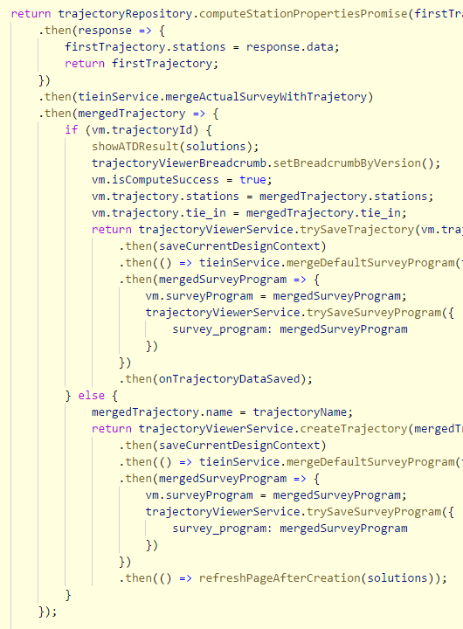
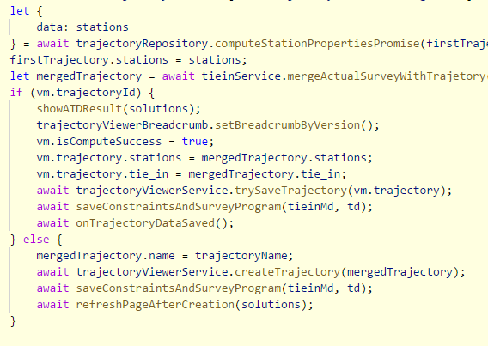
Usage of async
Purpose : write async code in sync style

Slide 4
Syntax of async
async function demoAsync(){
…
await doSomethingAsync(…);
…
}
demoAsync();
doOtherThings();

Slide 5
Tips of using async&await
async functions always return promise
use await inside async functions
use try catch if necessary

Slide 6
Tips of using async&await (cont.)
async functions are started synchronously, settled asynchronously
parallelism

Slide 7
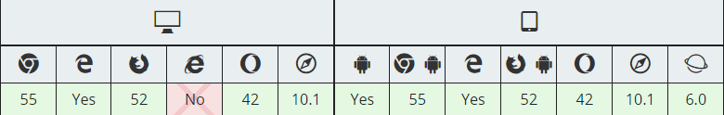
use async with ES5
babel
babel-preset-env
babel-polyfill http://babeljs.io/docs/en/babel-polyfill
webpack
babel-loader https://github.com/babel/babel-loader
eslint
ecmaVersion https://eslint.org/docs/user-guide/configuring

Slide 8
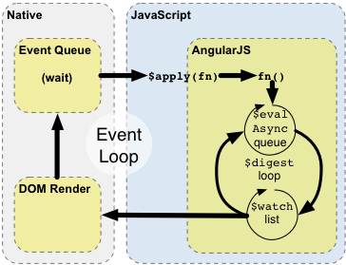
async in angularJS
$q is a Promises/A+ compliant implementation
different from promise in ES6
$rootScope.$evalAsync(callback)

Slide 9
async in angularJS (cont.)
make sure scope.$digest() is called in the end of async calls
wrap in decorator https://medium.com/@alSkachkov/using-async-await-function-in-angular-1-5-babel-6-387f7c43948c

